Slide 1
Analyzing Micro-Expressions for Lie Detection using Computer Vision
Group no-11
Name Reg. number
Ujjawal Kumar Verma 2201020428
Abhishek Kumar 2201020642
Nitish Paramanik 2201020433
Ravi Anjan Kumar 2201020409

Slide 2
TABLE OF CONTENTS
01
02
03
04
Introduction
Dataset Overview
MediaPipe Landmark Extraction
05
06
Dataset Preprocessing & Splitting
Model Building
Conclusion & Future Scope

Slide 3
Introduction
1. Traditional lie detection methods like polygraphs are intrusive and often unreliable.
2. Micro-expressions are brief, involuntary facial movements that can reveal hidden emotions.
3. These expressions are hard to fake and offer valuable cues for detecting deception.
4. Manual detection of micro-expressions is difficult due to their fleeting nature.
5. This project uses computer vision and deep learning to automatically detect lies from facial micro-expression sequences.
6. The system uses facial landmark tracking and temporal dynamics to understand subtle muscle movements.
7. A combination of CNN and RNN models helps capture both spatial and time-based expression patterns for accurate classification.

Slide 4
Dataset Overview
The dataset is sourced from Kaggle and contains facial image sequences labeled as 'Lie' or 'Truth'.
Each subject responds to questions like "What is your name?" or "What is your profession?" captured as frame sequences.
The folder structure is organized into Train and Test sets, each with separate folders for 'Lie' and 'Truth' responses.
Structure:
Micro_Expression_Dataset/
├── metadata/
├── Train/
│ ├── Lie/
│ └── Truth/
└── Test/

Slide 5
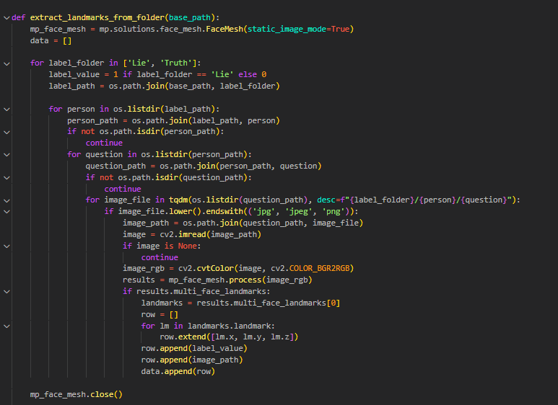
MediaPipe Landmark Extraction
Initializes MediaPipe’s face mesh
Processes one frame and extracts 468 face landmarks
Each landmark contains x, y, z coordinates
Useful for spatial and temporal pattern detection
Output Explanation:
face_mesh is ready to detect facial landmarks from static images.

Slide 6
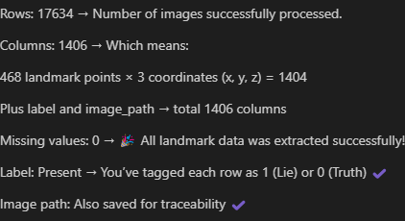
Landmark Coordinates Extraction
Reads the image from the given path.
Converts it from BGR (OpenCV default) to RGB (required by MediaPipe.
Processes the image using face_mesh.
Extracts x, y, z coordinates from the first detected face's 468 landmarks.
Returns a flattened list of coordinates (total of 1404 values per image).

Slide 7
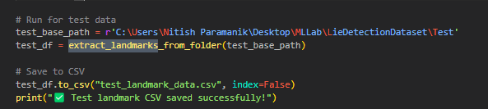
Dataset Summary & Visualization
Loads the previously saved landmarks.csv file into a DataFrame.
Uses Seaborn to create a count plot that shows the distribution of the label column (0 = Lie, 1 = Truth).
Displays the plot with matplotlib.

Slide 8
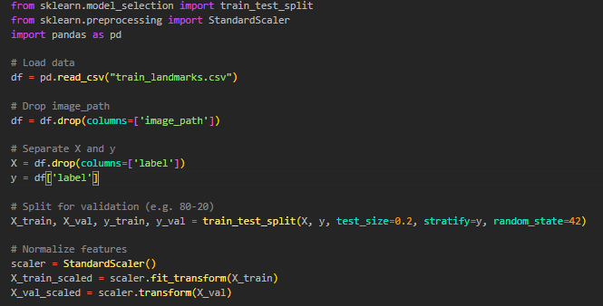
Dataset Preprocessing & Splitting
Loads landmark features and labels from train_landmarks.csv.
Drops the image_path column as it is not needed for model training.
Separates input features X and target labels y.
Splits the dataset into training (80%) and validation (20%) sets.
Normalizes the data using StandardScaler for better model convergence.
Output
Successfully created normalized training and validation datasets ready for model training.

Slide 9
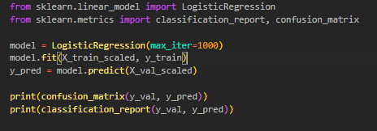
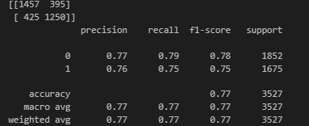
Model Building
A LogisticRegression model is created with max_iter=1000 to ensure it converges during training.
The model is trained on the scaled training data (X_train_scaled, y_train).
Predictions are made on the validation set (X_val_scaled) using the trained model.
Output
The model achieved 77% accuracy with balanced performance, showing precision and recall around 75–79% for both classes.

Slide 10
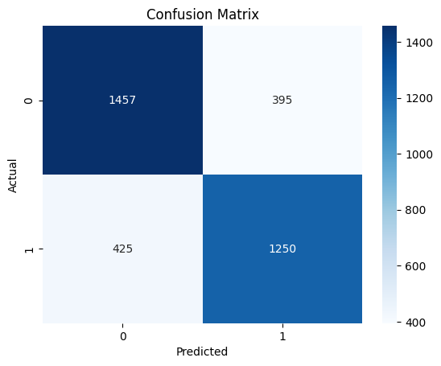
Model Evaluation (Confusion Matrix)
Performance Insight
The model is performing quite well overall.
It's slightly better at detecting Lies (high TN) than detecting Truths (slightly more FNs).
To improve: Focus on reducing False Negatives so it doesn’t miss lies.

Slide 11
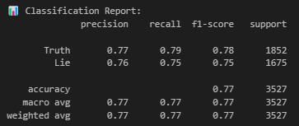
Metrics Summary
Shows model performs well on all metrics; borderline cases are the primary error source.

Slide 12
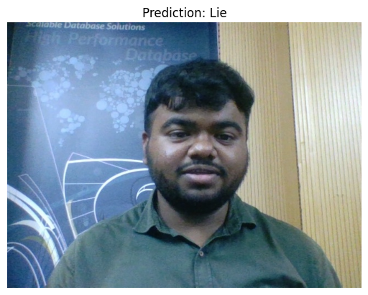
Real-time Lie/Truth prediction using webcam input

Slide 13
Conclusion & Future Scope
Successfully classifies Lie vs Truth using facial landmarks
Simple model with good performance
Future: Use video sequences, temporal modeling (e.g., LSTM)
Real-time deployment using webcam and OpenCV
Summarizes project success and opens doors to advanced model development and real-time systems.

Slide 14
Thank You!!

